Slide 1
Kirklees Third Sector Leaders: Focus on Health and Social Care
Emily Parry-Harries, Public Health Consultant
Steve Brennan, Senior Responsible Officer for Integration and Working Together

Slide 2
Contents
What we are doing in Kirklees
West Yorkshire and Harrogate Context
National context
Focus and opportunities

Slide 3
Kirklees
Integrated Arrangements – a quick overview of these

Slide 4
Integrated Governance Arrangements
Integrated Commissioning Board
Integrated Provider Board
Kirklees Health and Social Care Executive Group
Kirklees Integrated Workforce Development Steering Group

Slide 5
Integrated Commissioning Board
Areas of focus first 12 months:
Unified approach to quality
Unified approach to intelligence
Communications, engagement, equality
Unified approach to outcomes
Integrated Commissioning Strategy
Integrated Provision

Slide 6
Integrated Commissioning Board
Areas of focus next 12 months:
Digital
Estates
Workforce
Primary Care Networks

Slide 7
Integrated Provider Board
Areas of focus first 12 months:
Primary Care Networks
Integrated Community Capacity Model
Integrated Intermediate Care and Reablement
Integrated End of Life

Slide 8
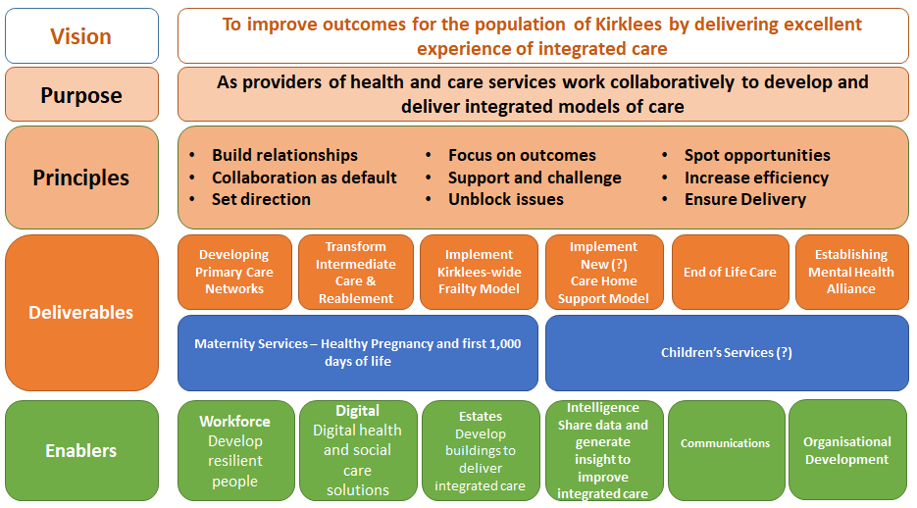
Integrated Provider Board
Areas of focus next 12 months:

Slide 9
Health & Social Care Executive Group
Areas of focus:
Forum to talk about Kirklees as a place
Help to build Kirklees voice within WY & Harrogate H&C Partnership
Narrative to support Health and Wellbeing Plan
Links to other work

Slide 10
Integrated Care Workforce Development Steering Group
Areas of focus:
Not instead of organisational workforce arrangements
Looking for what can be added by working together
Workforce Strategy by end of May 19
Supporting wider systems leadership

Slide 11
West Yorkshire & Harrogate Context
Here to stay
Increased emphasis/role
Helpful

Slide 12
National Context
Integration of Health and Social Care
NHS Plan emphasises this
Social Care Green Paper
Possible System Changes
Locally led

Slide 13
Areas of Focus and Opportunities
Kirklees Health and Wellbeing Plan and 7 Kirklees Outcomes
Primary Care Networks
Population Health Management
Wider Systems Leadership & workforce

Slide 14
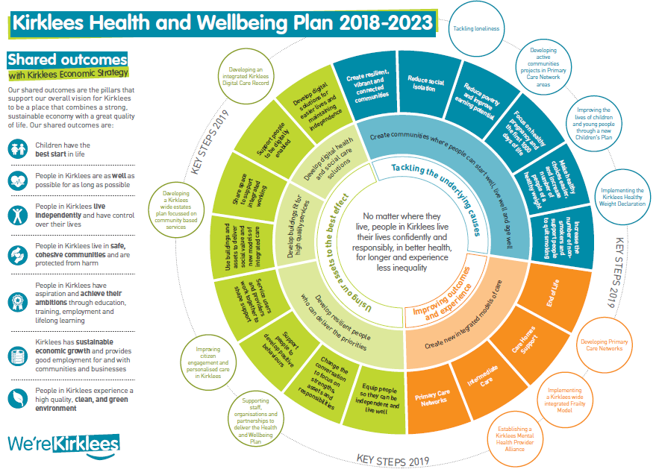

Slide 15
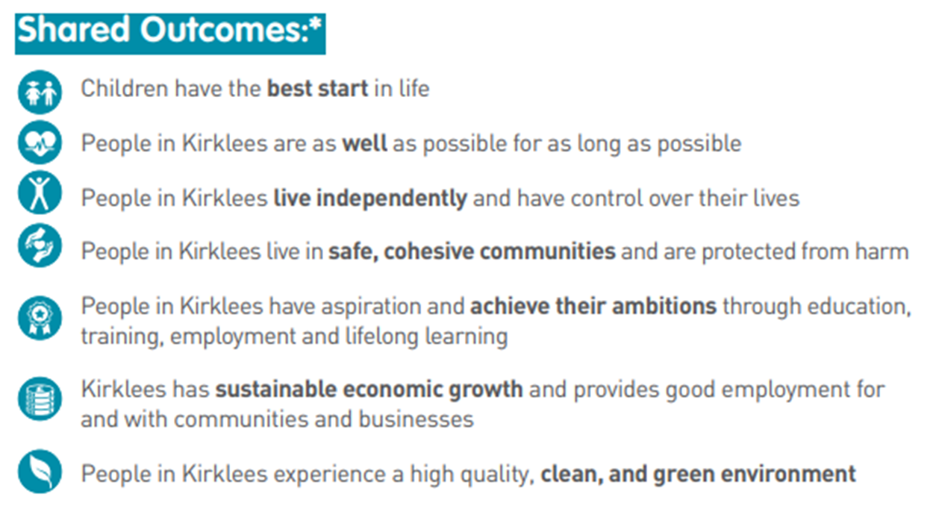
7 Kirklees Outcomes

Slide 16
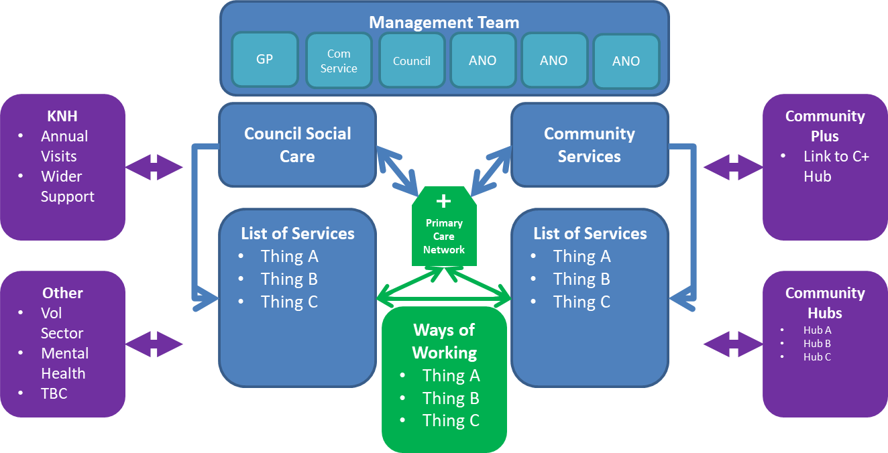
Primary Care Networks – Our Vision

Slide 17
Primary Care Networks – National Focus
Funding tied to setting up networks
Workforce: Clinical Pharmacists, physiotherapists, physicians associates, community paramedics, social prescriber
7 national services specifications which include one around reducing inequalities
Increasing emphasis on partnerships

Slide 18
Population Health Management
‘the health outcomes of a group of individuals, including the distribution of such outcomes within the group’

Slide 19
Population Health Management
Determinants of Population Health:
Access to health & care services
Lifestyle
Influence of local environment
Wider determinants of health – conditions in which people are born, live & work

Slide 20
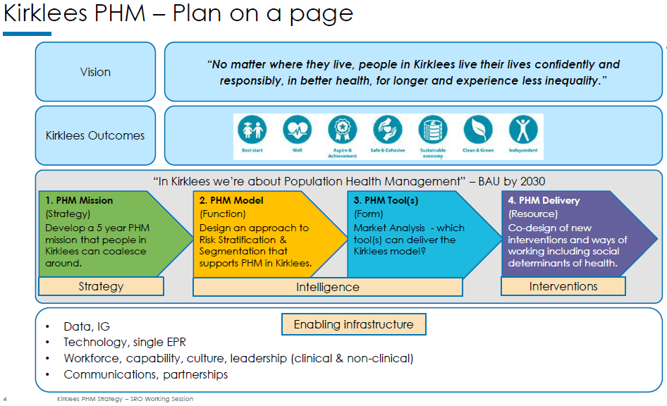
Population Health Management

Slide 21
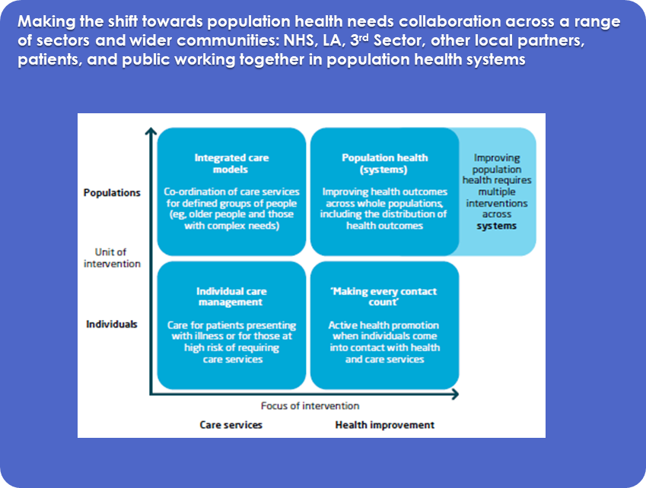
Population Health Management

Slide 22
Wider Systems Leadership & Workforce
Systems Leadership Events:
140 people, 40+ organisations
Focused on delivering outcomes and co-production
Building relationships as a way of getting things done
More to come

Slide 23
Wider Systems Leadership & Workforce
Workforce Strategy:
Apprenticeships
Promoting health and care careers
Promoting Kirklees as a place to work
Co-ordinated approach to training across organisational boundaries

Slide 24
Wider Systems Leadership & Workforce
Workforce Strategy:
Strengthening links with the University requirements
Really understanding and then moving towards a flexible workforce that helps to integrate service delivery

Slide 25
Summary
More integrated ways of working around the needs of individuals and local populations
Collaboration across a range of partners including the voluntary sector
Relationships are key
Voluntary and 3rd Sector are key partners in this

