Slide 1



Working for Carers
Ann Marie Brabiner
Working Carers Partnerships & Development Specialist
Icons made by Freepik from Flaticon.
Notes:
Partnership between Carers Count, Carers Trust and Working for carers

Slide 2

Working for Carers
Definition of a Carer
A carer is anyone, including children and adults who looks after a family member, partner or friend who needs help because of their illness, frailty, disability, a mental health problem or an addiction and cannot cope without their support. The care they give is unpaid.
Icons made by Freepik from Flaticon.
Notes:
Becoming a carer can happen overnight and be unpredictable, caring milestones can be different eg a disabled child may still be at home as a disabled adult. Caring often end with a move into residential care or bereavement bringing its own complications.
Every year 2 million people become carers so we have new populations in our workforce every day.

Slide 3
Working for Carers
There are only four kinds of people in the world
Those who have been caregivers
Those who are current caregivers
Those who will be caregivers
Those who need caregivers
Icons made by Freepik from Flaticon.
Notes:
Caring is everyday life of families yet we estimate 600 people a day give up paid work to care

Slide 4


Nearly 1 in 8 employees are a carer
Appropriate policies & line manager training severely lacking
Peak age for caring is 45 – 64
1/3 of the UK’s workforce 50+ by 2020
Stigma & lack of awareness
2.3 million quit work to care
3 million have reduced their hours
Flexible working is not a day 1 right
Over half of those not working would like to be
Notes:
According to Carers Trust, nearly 1 in 8 employees are carers.
Peak age for caring = peak age for careers. 45-65
Continuing rise in the number of carers → more ppl juggling work & care.
Huge numbers of carers have reduced their hours or quit work completely, and many of those not working would like to be.
In Kirklees the 2011 consensus showed 45000 carers 1 in 6 give up work
Working carers often rely on being able to work flexibly, and the fact that flexible working is not a day 1 right is a significant barrier.
Stigma is also still an issue; many carers feel awkward – even scared – to discuss their caring responsibilities with their employer.
2016 study by CIPD found workplace policies & training woefully lacking in the majority of businesses – just 13% offer line manager training to support working carers. (CIPD/Westfield Health research, 2016)
Whilst workplace policies and employer attitudes not entirely to blame for the difficulties WCs face, they do play a significant role and are relatively easy to address.

Slide 5

Hidden in plain sight
Many don’t realise they are carers
Caring is an emotional subject
Fear of judgement
Fear of discrimination
Work provides a mental break
Self-preservation

Slide 6
An employer-focused approach
Culture-change
89 %
88 %
89 %
34 %
38 %
12 %
- Supportive employer
- no support from employer
- option to work flexibly
- option to work flexibly
- paid care leave
- paid care leave
Notes:
Working for Carers is a membership and accreditation scheme for employers. Blue- carers asked whats important red what is offered Massive gaps
We help companies to support and engage with the carers in their workforce by addressing the culture of the organisation and encouraging positive change through multiple channels.
Asked what support from their employer would be most important if combining their job with unpaid care for a loved one,
89 per cent of UK adults said a supportive line manager/employer,
88 per cent said the option to work flexibly, and
80 per cent said five to 10 days paid care leave.
38 per cent of UK employees said their employer had flexible working but only 12 per cent said they had additional paid care leave. A third (33 per cent) of people currently juggling work and care said that there were no policies listed to support carers.

Slide 7
An employer-focused approach
Questions to ask about your organisation?
How do you enable carers to identify & recognise themselves?
How are you making your support for carers transparent?
What practical provision and arrangement are available for carers?
How are you connecting & engaging carers?

Slide 8
An employer-focused approach
Offer To employers
Working For Carers- Digital resources
Carers UK- EFC Digital
Working Carers Forum (Kirklees)
Local Carer Support Organisations

Slide 9
The offer to employers
Online resources
E-training for line managers
Working for Carers charter
Accreditation badge
Company listing in our Members Directory
Events

Slide 10

Outstanding Employer accreditation
Requires evidence of policies and procedures which demonstrate carer-awareness and support in the workplace
No additional cost
Self-assessment process
Valid for 3 years
Opportunity for positive PR

Slide 11

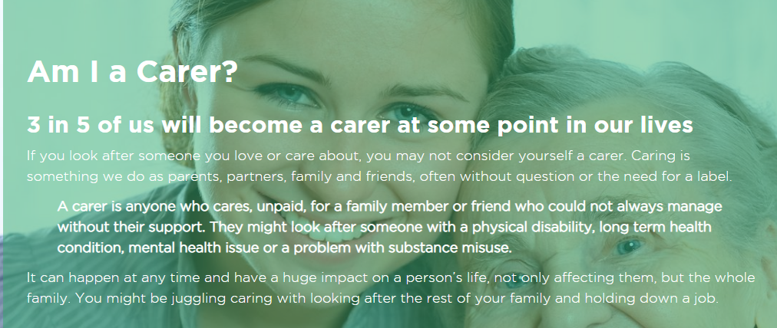
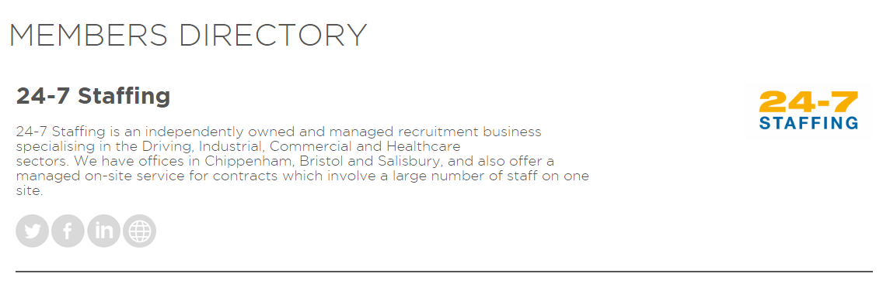
Working for Carers Website

Slide 12
The offer to employers from Carers UK
EFT digital platform
Case studies, model policies, FAQ’s,Toolkit, e learning modules
and top 10 tips
Digital resources for carers
Carers Confident scheme- 3 levels (Self assessment)
Regular communication- e bulletins
More
Notes:
If Sme with under 250 employers in Kirklees can access resources for free while Kirklees has the umberella membership. Once this membership stops

Slide 13
Partnership Working
Working Carers Forum ( Kirklees)
AIM- To build a network of carer aware employers to lead the way in supporting working carers in Kirklees
Opportunity to share best practices and ideas to support working carers
Improve understanding of services locally offering support
To share expertise across organisations for the benefit of workforce development

Slide 14
Support available in Kirklees- Starting point
Carers Count
Carers Trust
Kirkwood Hospice
PCAN Parents of Children with Additional Needs
Care Navigation
Notes:
Carers count act as the singlepoint of contact for carers in Kirklees. Call for an informal chat to see how we can help.
Benefits (Disability Living Allowance for children, Personal Independence Payment, Attendance Allowance, Carers Allowance) and many others. We provide benefits checks and can help to fill out the forms.
· Grants
· Support and practical help for the carer and the person they care for through Social Services (this may include financial assessment and help).
· Disability Equipment
· Assistive Technology (for example care phones)
· Blue badges (for disabled parking)
· Other transport help
· Other specialist services relevant to the person’s needs
· Respite Care (to give the carer a break)
We offer home visits if that is more convenient or carers can be seen in the office, either by appointment or in our drop in sessions when an appointment is not necessary. These take place between 10am and 2pm every Tuesday.
To access our service telephone on 0300 012 0231 or email info@carercount.org.uk.
Carers count also offers an advocacy service, groups, wellbeing events and activities and training. How best to self advocate, moving and handling, signposting to the many services and navigating through health & Social care.
Carers Trust Emergency support service, respite, groups for family members in the week, carer training
Kirkwood support carers through share and care- a program of training looking at wellbeing, nutrition, looking after vulnerable skin, moving and handling, coping skills, living with fatigue, mindfulness
Pcan Support parents of children with additional needs
Understanding rights to a carers assessment or a person led assesement for the person you are looking after. Looking at getting a break
Carers linking with community plus for cared for or themselves to look at getting out more and building social networks.

Slide 15
What Employers can do?
Carer friendly policies
Flexible working practices
Offer individual tailored support
Paid leave for emergency or planned care
Supportive culture from managers
Workplace support with in house networking groups
Publicise policies to show transparency
Practical support
Signposting
Notes:
Take simple and effective action
Carer friendly policies help to recruit the 1.5 million carers of working age who are actually not working
Offering flexible working patterns- evidence shows rarely abused and increases loyalty. Flexible options for all reduces resentment about preferential treatment
Talk to the individual about what will help them- A blanket approach will not work
A few days paid leave is cheaper than recruiting if carers gives up work
Having a supportive and understanding manager goes a long way to improve moral, increase loyalty and improve productivity and flexibility.
Its good to know you are not on your own, carers learn about vital support by talking with each other
Good communication on offer is vital to encourage carers to identify and ask for help. Clear for all parties involved
Some times arers will need practice support eg private room to take a call, car parking space
Carers say getting the right information at the right time is vital- as an employer know where to signpost for information locally

Slide 16



Who benefits?
Notes:
Carers: as well as a reliable income, work can be an escape from the demands of caring. It provides a sense of identity and can be a welcome mental break from caring.
Being able to more easily juggle work and care means less stress for the carer, and improved care for the person they care for.
Businesses: retention of experienced staff and valuable skills; fewer costs related to recruitment and lost productivity; less stress and higher morale; improved employer brand helping to attract new talent.
Communities: Direct link to local carer support services → more working carers signposted to support → improving their long-term resilience and ability to stay in work. The scheme is self-funding, so just by being a member, businesses are helping local charities to support their community. This added social value can strengthen companies’ bids for new contracts.
SME: Losing a staff member hugely devastating → bigger impact on turnover & competing against larger brands for talent → retention higher priority.
Greater community resilience → good for local authorities…

Slide 17


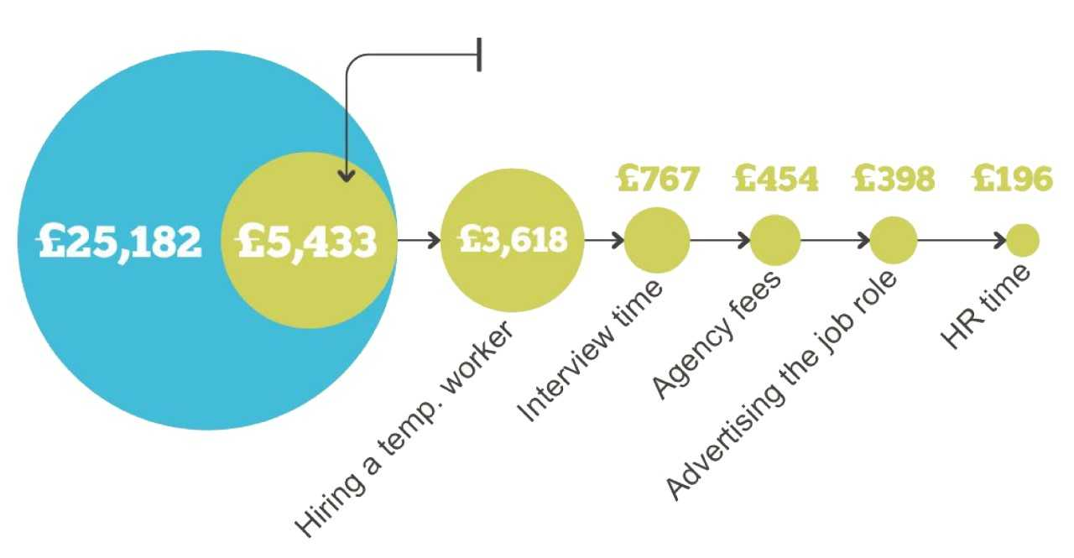
Cost of replacing ONE employee
Logistical cost of replacing an employee
Cost of bringing an employee up to their Optimum Productivity Level (OPL)
Notes:
According to research by Oxford Economics and Unum, the average cost of turnover per employee (earning £25,000 a year or more) is £30,614.
The research states that employers spend an average of £5,433 on finding a replacement.
That includes
recruitment or advertising fees, which are typically around 10-20% of the job’s annual salary;
Interviewing which will cost around £1,000 for each role
HR time – whether that’s in house or external
Temporary replacement costs
Once the right candidate has been found, there are induction and training costs, but the biggest cost to employers comes from loss of productivity.
It will take some time for your new employee to produce the same level of work as the person they replaced. Oxford Economics and Unum say that, on average, it takes 28 weeks and costs around £25,182 for loss of productivity.

Slide 18
Cost Savings for Employers

Slide 19
Membership prices

Slide 20





















Notes:
Over 30,000 employees

Slide 21
For more information…
Ann Marie Brabiner
Partnerships & Development officer
Annmarie.Brabiner@carerscount.org.uk
07802878658 Wednesday-Friday 9.30 -2.30
0300 012 0231 Carers Count Office Mon-Fri 9.00-5.00
Icons made by Freepik from Flaticon.

