Slide 1






TSL Community Anchor Network
Helping local groups make great things happen

Slide 2








The Community Anchor Network
SeeTSL Community Anchor Postcard (tslkirklees.org.uk) for contact details of Lead Anchors
Yorkshire Children's Centre (YCC)
Huddersfield Mission
Indian Muslim
Welfare Society (IMWS)
TBC
Local Services 2 You
Batley/Spen
The Branch
(Jubilee Centre)
Support 2 Recovery (S2R)
Huddersfield
Dewsbury/Mirfield
Thornton Lodge Action Group
Rural
Ravensthorpe Community Centre
Denby Dale
Centre
Locorum
Valleys Anchor Network
TBC

Slide 3
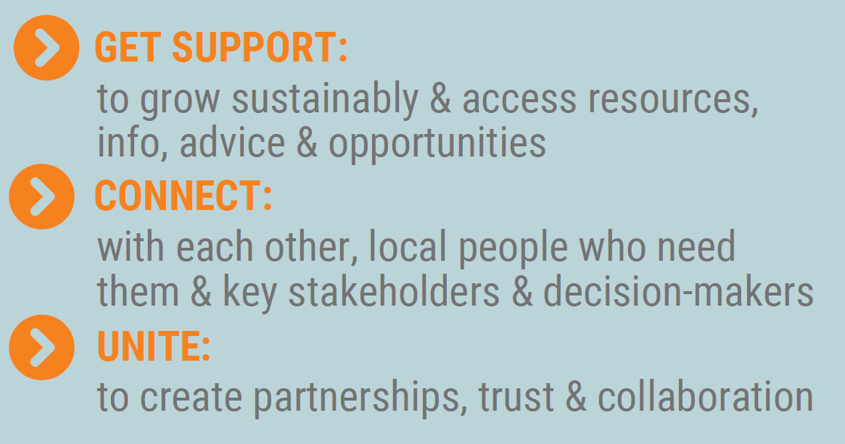


Helping community orgs to…
Welcome!
Activities and
volunteering
this way!
Support
and resources
Helping local groups make great things happen

Slide 4
Anchors Update Jan 2022
Progress
Community Anchor met as the Network on Tue 11 Jan
Lead Anchors have development plans, budgets and contracts agreed
Local Anchors plans in development
TSL & Lead Anchors meeting monthly
Anchors meeting with Social Prescribing Leads
Rural and Batley & Spen piloting community directory
Valleys Community Anchor Network development work underway
Support
and resources
Helping local groups make great things happen

Slide 5
Anchors Update Jan 2022
Next steps
Next Anchor Network meeting 13 Apr
Interim evaluation by end of May 2022
Lead Community Anchors meet monthly
Anchors organise networks and attend other community meetings
Covid Community Champions work being led by Anchors
Funds allocated to support local anchor development
Communications plan
Report to commissioners on Oct-Dec period
Support
and resources
Helping local groups make great things happen

Slide 6
Thank you
We are
Third Sector Leaders Kirklees (TSL)
Bridget Hughes
Supporting
Communities Lead
Tom Taylor
Community Anchor Lead
Bridget@tslkirklees.org.uk
Tom@tslkirklees.org.uk

